Slide 1
Change Healthcare Ransomware Attack
Sairam Bokka
VX05251

Slide 2
01
04
Breach Overview
Who is BlackCat/ALPHV?
02
05
Who is Change Healthcare ?
Detailed overview of attack
03
06
How the breach happened?
Mitigation Strategies

Slide 3
01
BREACH OVERVIEW
What just happened?!

Slide 4
BREACH OVERVIEW
On Feb. 21, 2024, Change Healthcare publicly disclosed that it had been impacted by a cyberattack (Ransomware Attack).
BlackCat/ALPHV claimed responsibility for this attack and demanded money to return services online.
The impact of the Change Healthcare cyberattack has been devastating for the healthcare industry and hundreds of millions of Americans who rely on services powered by victimized providers.
In a message posted on X (formerly Twitter) included a transaction link and claimed that a $22 million ransom in the form of 350 Bitcoins was paid on March 1

Slide 5
02
Who is Change Healthcare?
Overview of Change Healthcare

Slide 6
Who is Change Healthcare?
Change Healthcare is a healthcare technology company that is headquartered in Nashville, Tenn., with locations across the U.S., Canada, the United Kingdom, New Zealand, Israel and Taiwan.
Change Healthcare was founded in 2007 and was acquired by UnitedHealth Group (UHG) and its Optum Insight business unit in an $8 billion deal that closed in October 2022.
Change Healthcare provides services such as :
Payment and revenue cycle management
Claim processing
Clinical Decision Support
Patient Engagement Tools such as patient portals

Slide 7
03
How the breach happened?

Slide 8
How did the breach happened?
Ransomeware Deployment
Key Operations Disrupted
Unauthorized Initial Access
Incident Response
Once inside the Change Healthcare network, the attackers deployed ransomware
the attack disrupted key operations, forcing healthcare providers and pharmacies to deploy workarounds to continue providing services.
Change Healthcare responded to the attack by disconnecting more than 111 different services across its system to prevent further damage.
Blackcat/ALPHV gained initial access to change healthcare’s network

Slide 9
BREACH TIMELINE
Feb 21, 2024
March 1, 2024
March 18, 2024
Feb 28, 2024
March 7, 2024
Change Healthcare suffered a cyberattack
Security Researchers discover that a payment was made
Expected Full System Recovery
BlackCat/ALPHV claims responsibility
Perscription claim submissions and payment systems were restored

Slide 10

04
Who is BlackCat/ALPHV

Slide 11
Who is BlackCat/ALPHV?
BlackCat/ALPHV operates with a ransomware-as-a-service (RaaS) model. In the RaaS approach, BlackCat/ALPHV enables affiliates to attack victims with its ransomware code, who are then paid a share of any ransomware payment.
The BlackCat ransomware gang, also known as ALPHV, claimed responsibility for the attack against Change Healthcare. BlackCat/ALPHV is the same group that was allegedly behind the attacks on Caesars Entertainment and MGM Resorts in September 2023.

Slide 12
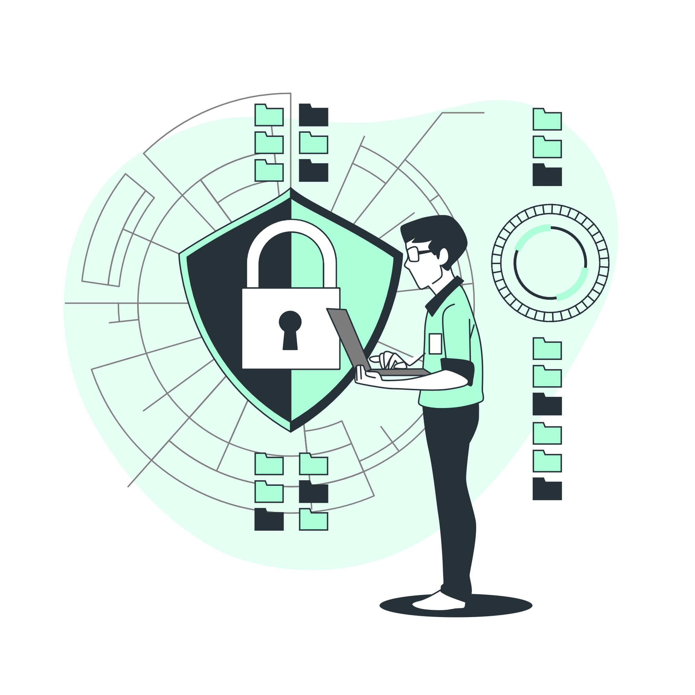
Who is BlackCat/ALPHV?
BlackCat ransomware group, which was infiltrated by the FBI and foreign law enforcement partners in late December 2023.
Government seized the BlackCat website and released a decryption tool to help victims recover their systems.
BlackCat responded by re-forming and increasing affiliate commissions to as much as 90 percent.
The ransomware group also declared it was formally removing any restrictions or discouragement against targeting hospitals and healthcare providers.

Slide 13

05
Detailed Overview of the attack

Slide 14
Detailed Overview
Initial Access - Social engineering techniques and open-source research on a company. [T1598]
Deploy remote access software such as AnyDesk, Mega sync, and Splashtop in preparation of data exfiltration.
ALPHV Blackcat affiliates create a user account, “aadmin,” and use Kerberos token generation for domain access [T1558].
Remote access and tunneling tools, such as Plink and Ngrok [S0508].
Brute Ratel C4 [S1063] and Cobalt Strike [S1054] as beacons to command and control servers.

Slide 15
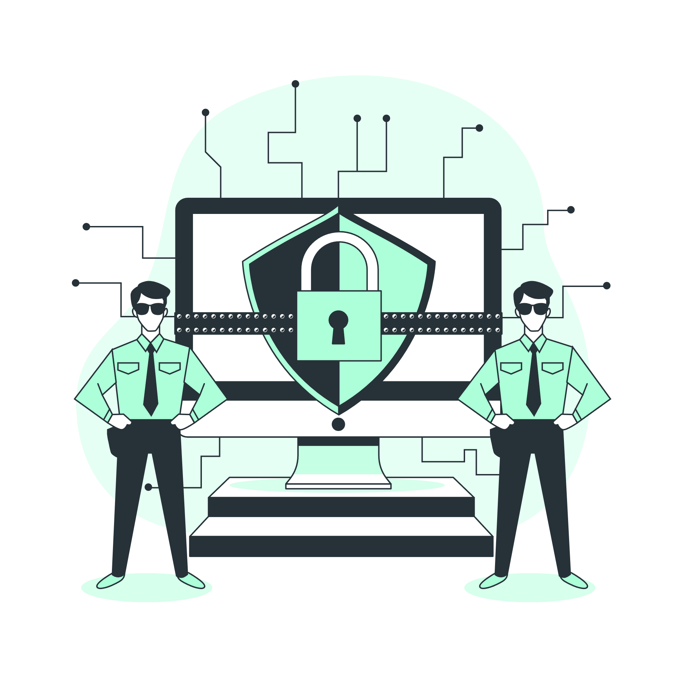
Detailed Overview
ALPHV Blackcat affiliates use the open-source adversary-in-the-middle attack [T1557] framework Evilginx2, which allows them to obtain multifactor authentication (MFA) credentials, login credentials, and session cookies.
The actors also obtain passwords from the domain controller, local network, and deleted backup servers to move laterally throughout the network [T1555].
To evade detection, affiliates employ allowlisted applications such as Metasploit. Once installed on the domain controller, the logs are cleared on the exchange server.
Then Mega.nz or Dropbox are used to move, exfiltrate, and/or download victim data.

Slide 16

Detailed Overview
The ransomware is then deployed, and the ransom note is embedded as a file.txt.
According to public reporting, affiliates have additionally used POORTRY and STONESTOP to terminate security processes.

Slide 17
06
Mitigation Strategies

Slide 18
MITIGATION STRATEGIES
Implementing application controls to manage and control execution of software, including allowlisting remote access programs.
Implementing FIDO/WebAuthn authentication or Public key Infrastructure (PKI)-based MFA
Identify, detect, and investigate abnormal activity and potential traversal of the indicated ransomware with a networking monitoring tool.
Implement user training on social engineering and phishing attacks
Implement internal mail and messaging monitoring
Install and maintain antivirus software

Slide 19

Bonus Content

Slide 20
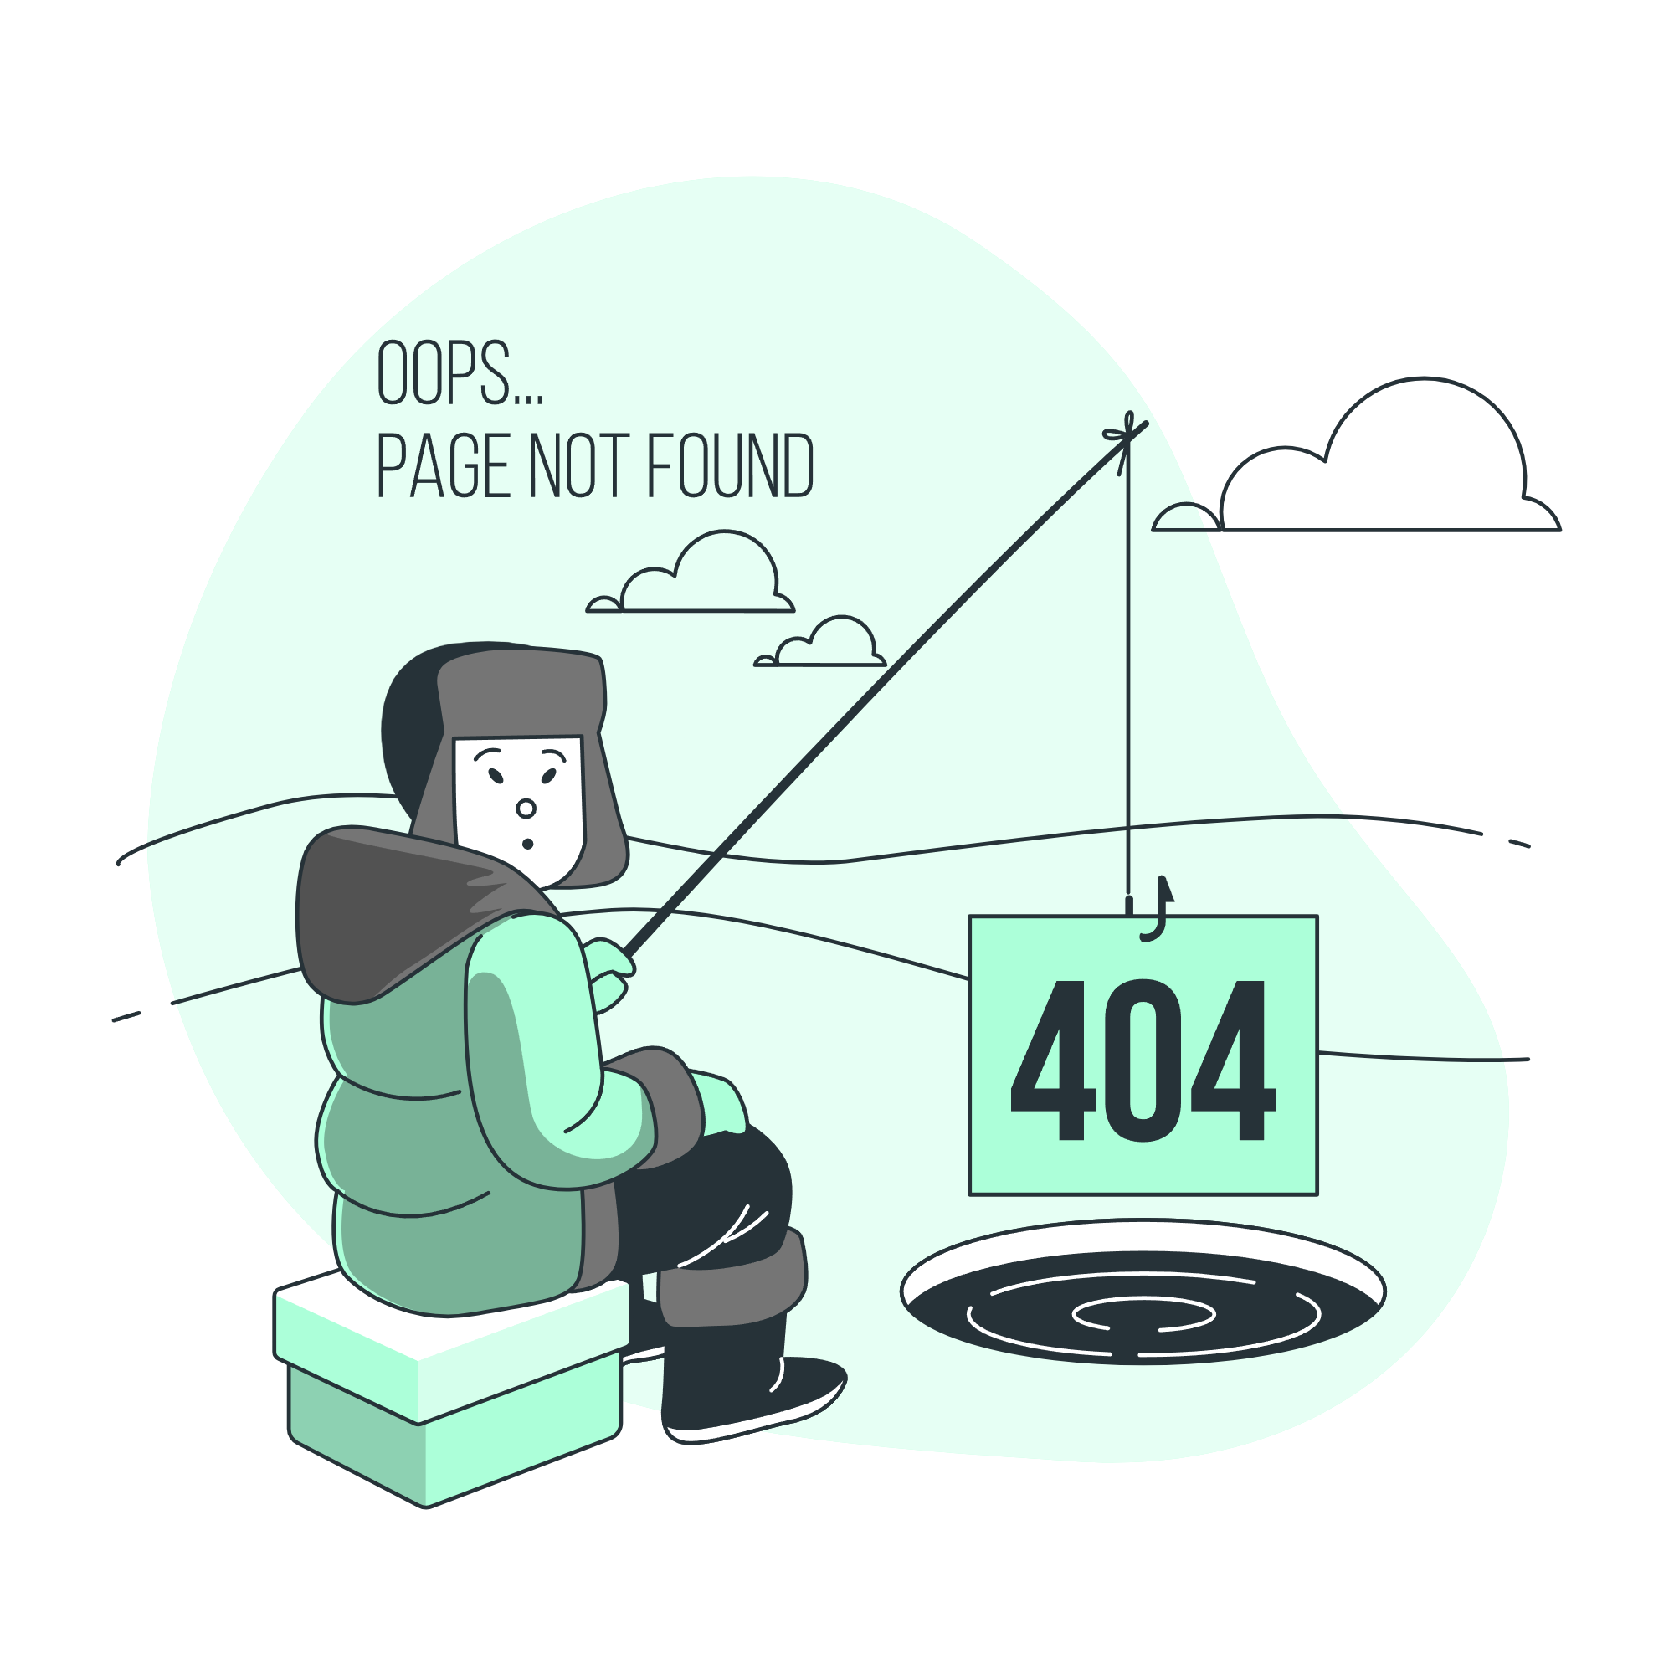
*BONUS*
Change Healthcare had paid a $22 million ransom for a decryption key, and to prevent four terabytes of stolen data from being published online.
The affiliate claimed BlackCat/ALPHV took the $22 million payment but never paid him his percentage of the ransom.
A representative for BlackCat said the group was shutting down and that it had already found a buyer for its ransomware source code.
Paying cybercrooks to delete stolen data is a losing proposition all around.

Slide 21

Thanks!
If you have any questions
Feel free to shoot them now!

